Slide 1
Setting Up Your Camera
A trawl through the menu

Slide 2
Introduction
Modern cameras are immensely complex pieces of electronic and mechanical engineering.
Basic controls, such as aperture, shutter speed, ISO and focus, however, are designed in much the same way they have been for decades.

Slide 3
Menu Structure
Your camera’s menu is usually divided into various parts:
Playback
Shooting
Custom Settings
Setup

Slide 4
Formatting your memory card
If you have a new memory card you will need to format it in-camera.
‘Format’ is usually found in the ‘set-up’ part of the menu.
Memory cards should be reformatted several times a year or more often if used heavily.
Formatting removes all the image files from the card.

Slide 5
Shooting Menu
If you choose to use RAW then some settings will not be available (greyed out)
For example, ‘image size’

Slide 6
Image Quality
You have a choice between JPEG or RAW or both (JPEG + RAW)
JPEG Fine (compression ratio 1:4)
JPEG Normal (1:8)
JPEG Basic (1:16)
RAW
Terms such as ‘Extra Fine’, ‘Fine’ and ‘Standard’ may also be used.

Slide 7
JPEG
The RAW captured image from your camera’s sensor is reduced from 12 or 14 bit to an 8-bit file to create a JPEG file in camera.
The in-camera processing will ‘bake in’ various values, such as: white balance, contrast, sharpness and noise reduction.
As Raw software has improved, storage capacities expanded, and processors quickened, many of the arguments to stick with JPEG are diminishing.

Slide 8
Advantages of JPEG files
Uses less memory.
Can support higher ‘drive’ or ‘burst’ rates than RAW.
Sport and nature photographers find this an advantage when capturing movement.

Slide 9
JPEG
JPEG stands for “Joint Photographic Experts Group”.
The compression is lossy (i.e. can’t be recovered)
The 16 million possible colours in the JPEG image are produced by using 8 bits for each colour (Red, Green and Blue) in the sRGB colour space.
This provides 2⁸ = 256 values for each of the three colours.
256 x 256 x 256 = 16 million colours.

Slide 10
Advantages of RAW
White Balance can be adjusted with precision
Recovery of shadow detail maximised
Recovery of highlight detail maximised
Contrast adjusted with precision.
Sharpening and noise reduction adjusted to taste.
Maximum colour gamut.

Slide 11
Memory is cheap
Nowadays it’s not necessary to use anything but the highest quality JPEGs unless you intend to store many hundreds of photos on a single card.

Slide 12
Aspect Ratio for JPEG
3:2 As in a frame of 35mm film (36 x 24)
4:3
16:9 Display in HD screen
1:1 As in square format cameras

Slide 13
Image Size for JPEG
Most cameras keep their file format selection within the main menus.

Slide 14
Image Size for JPEG
Large 4,896 x 3,264 pixels 16.0 Mp
Medium 3,456 x 2,304 pixels 8.0 Mp
Small 2,436 X 1,664 pixels 4.2 Mp
If you are only ever going to display your images on a screen, then 8 or even 4 Mp would be quite enough resolution.

Slide 15
Picture Control or ‘Creative Style’ for JPEG
When a JPEG is created in-camera, various styles may be ‘baked in’.
For instance: colour saturation, contrast and sharpness.
Nikon: standard, neutral, vivid, monochrome, portrait and landscape.
Fujifilm cameras have various film simulations.
Sony: Standard; Vivid; Neutral; Clear; Deep; Light; Portrait; Landscape; Sunset; Night; Autumn; B&W; Sepia

Slide 16
White Balance for JPEG and RAW
White balance (WB) ensures that colours are unaffected by the colour of the light source.
Auto WB 3,500 – 8,000K
Daylight 5,200K
Shade 8,000K
Cloudy 6,000K
Incandescent 3,000K
Fluorescent up to 7 to choose from

Slide 17
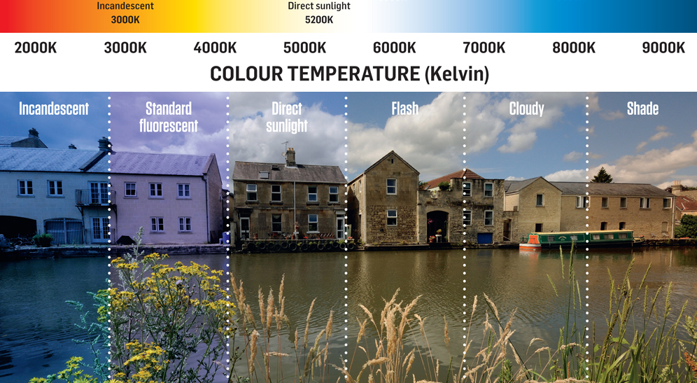
White Balance

Slide 18
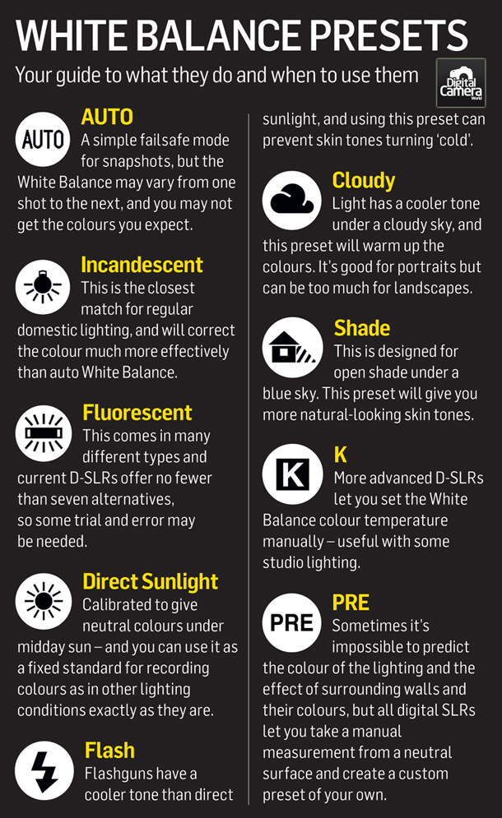
WB

Slide 19
WB
On some cameras it is possible to fine tune the various WB settings.
Choose a colour temperature 2,000 – 15,000K
Create “Custom WB” settings using a white surface (or pure grey).
The WB of JPEGs are baked in when they are created.
The WB of RAW files may be altered.

Slide 20
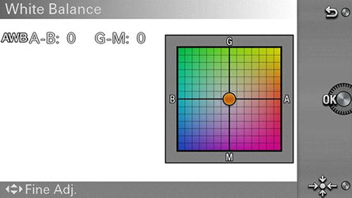
Fine Tune WB

Slide 21
Colour Space
Deep in the menus of your DSLR camera , and in some more advanced compact cameras, is an option for your colour space.
The two camera options you will be presented with are Adobe RGB and sRGB, which define how your image’s colour is captured.
In basic terms, Adobe RGB offers a wider colour gamut, which means that in some extremes, it is seeing more colours.

Slide 22
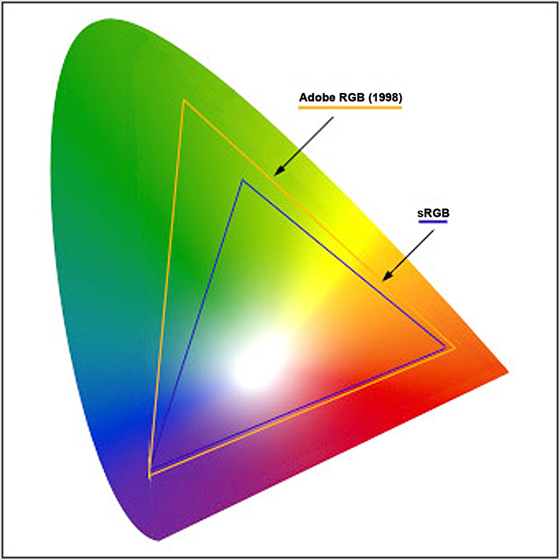
sRGB & AdobeRGB Colour Space

Slide 23
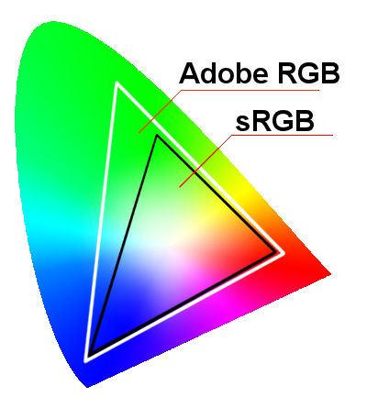
sRGB & AdobeRGB Colour Space

Slide 24
Colour Space
The Adobe RGB colour space is designed to cover all of the colours available when printing, and will potentially offer better reproduction.
However, most monitors will not show this full range and sRGB was designed with HP and Microsoft to allow a more accurate representation on screen of the colours.
sRGB is also the colour space used for anything web-based.

Slide 25
Colour Space
Unless you are using high-end printers, the amount of colours missed by sRGB is unnoticeable and most online labs will actually process in sRGB.
In summary, though Adobe RGB is generally deemed superior, sRGB is more user-friendly.

Slide 26
Colour Space & RAW
This setting does not apply to RAW files.

Slide 27
sRGB
sRGB is used by a wide variety of devices and is the standard colour space for displaying images on a screen.
For most occasions, sRGB should be used.

Slide 28
Adobe RGB
This colour space is intended for use in high quality/professional printing.
If you have to produce a JPEG or TIFF file from a RAW file, you will be asked to select either a sRGB or a Adobe RGB file.

Slide 29
Automatic focus/Manual Focus
Digital cameras have the ability to focus automatically (AF) or manually (MF)
AF can be highly sophisticated with, in advanced cameras, the ability to adjust many variables.
For instance: focus area, number of focus points, position of focus area.
Face/Eye Detection

Slide 30
Auto Focus Mode
Auto focus may be set as:
Auto Focus Single (AF-S)
Auto Focus Continuous (AF-C)
In AF-C, the camera will track a moving object and keep it in focus.

Slide 31
Drive Setting
The way in which the shutter is operated can be set up in various ways.
Single shot
Continuous or Burst mode: e.g., 6 frames per second
Self Timer
Bracket (e.g. ± 0.3 EV)
See example of burst mode!

